Slide 1
Fulbright Research Project
Totora reed balsas
& sustainable sculpture
Chimu, Lake Titicaca Peru
2012

Slide 2
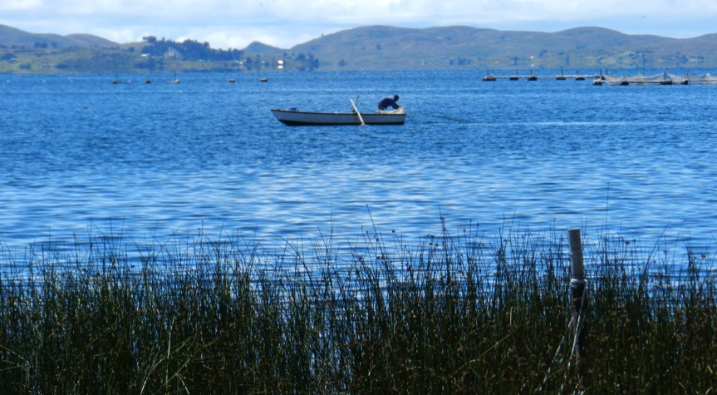
Totora Reeds in Lake Titicaca

Slide 3
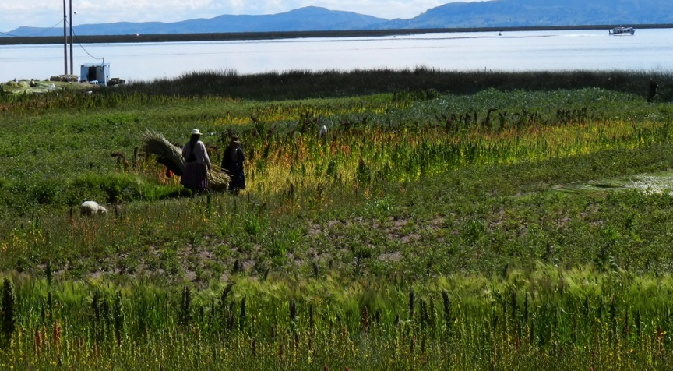
Women harvesting dried totora reeds in Chimu near Puno Peru

Slide 4
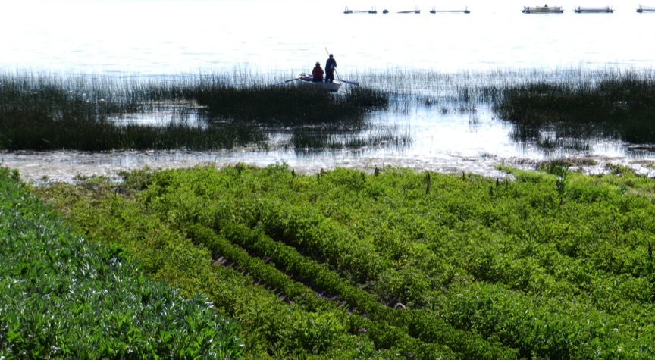
Fishermen amongst the totora reeds, Lake Titicaca

Slide 5
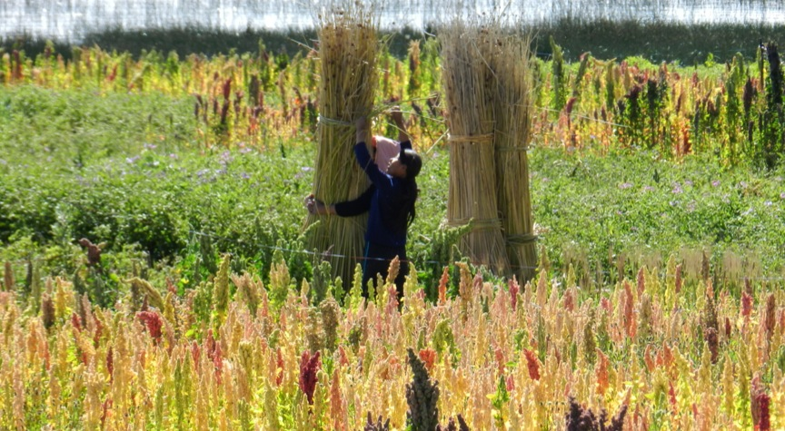
Preparing the dried totora reeds for market

Slide 6
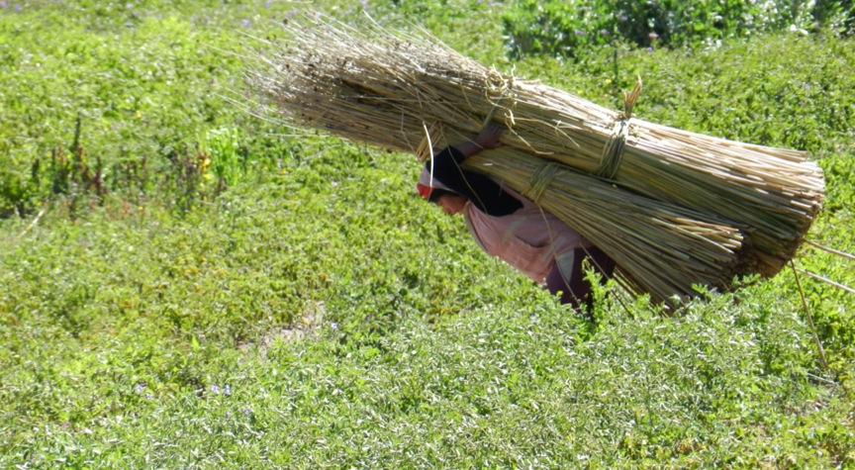
Transporting the reeds to sell

Slide 7
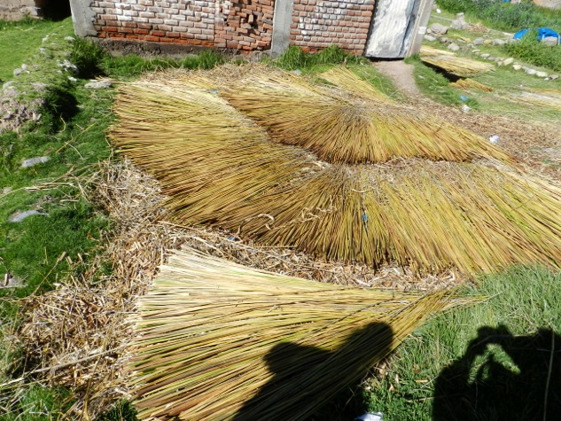
Drying the reeds requires 3 weeks

Slide 8
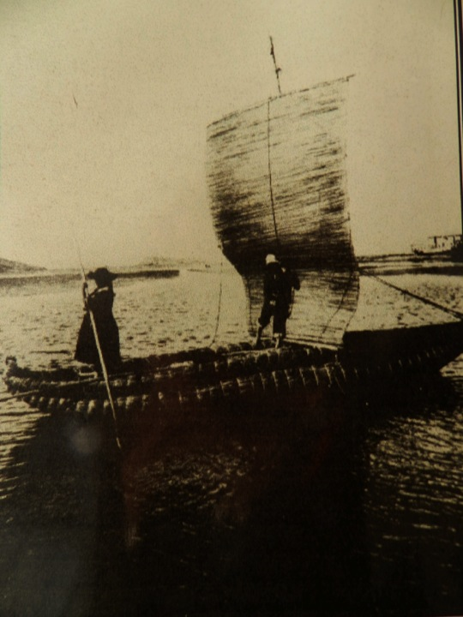
Historic Images of
Traditional balsa boat
Lake Titicaca

Slide 9
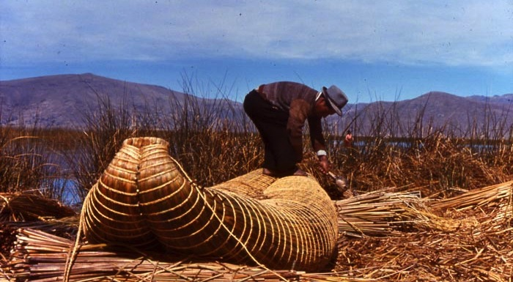

Slide 10
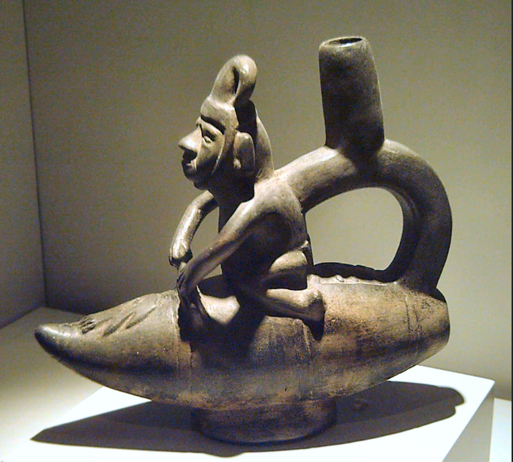
Balsa boats in Pre-Columbian Huacos

Slide 11
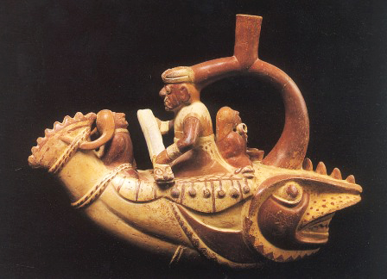

Slide 12
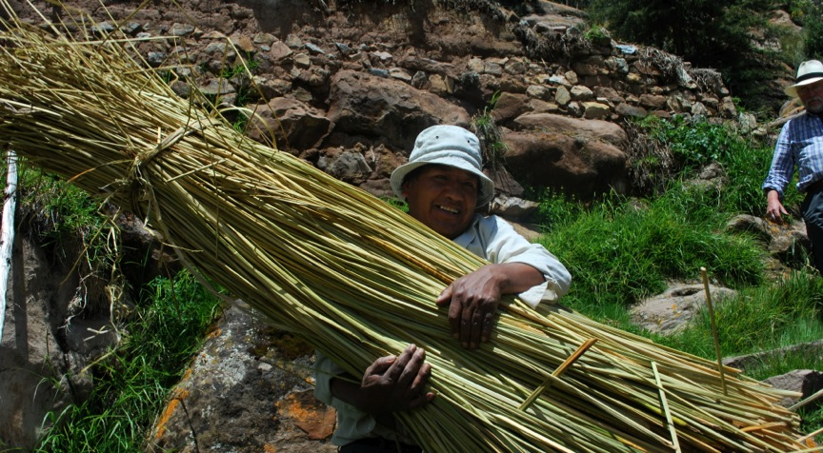
Juan Cuno Balcona
Aymara artisan

Slide 13
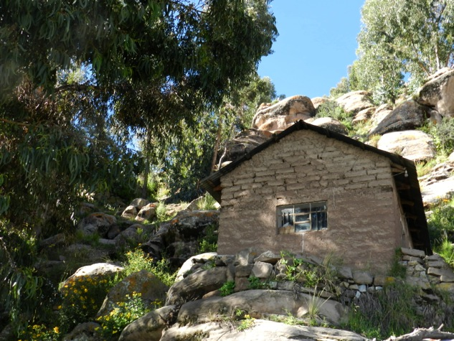
Juan’s home, Chimu

Slide 14
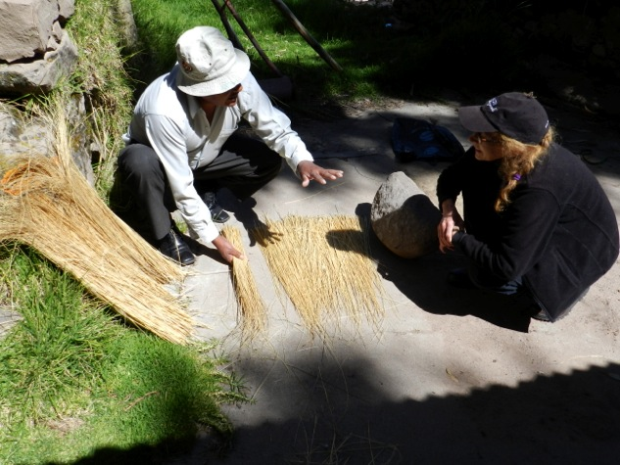
Learning how to prepare chilliqua grass to make rope with Juan

Slide 15
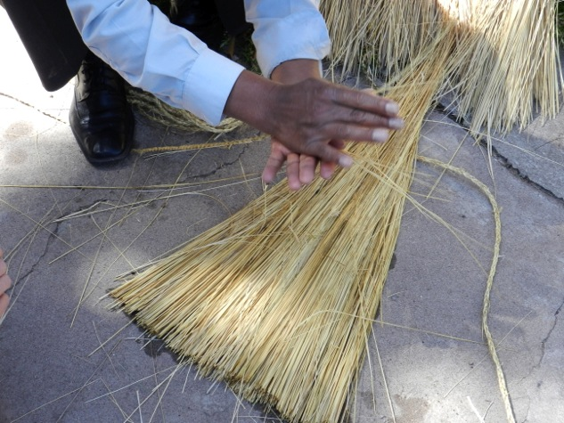
Chilliqua grass

Slide 16
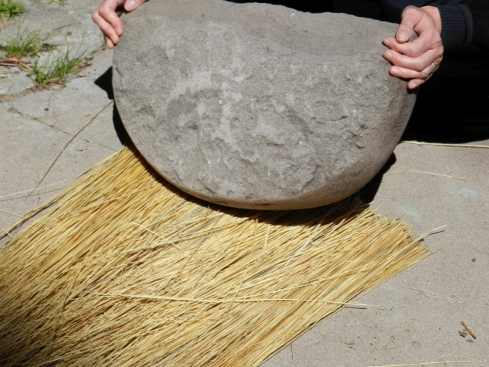
The chilliqua grass is crushed with a rock to make it pliable for braiding rope

Slide 17
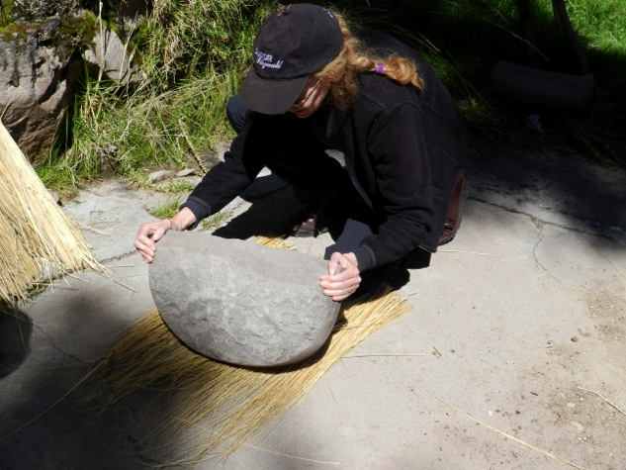
Crushing the chilliqua

Slide 18
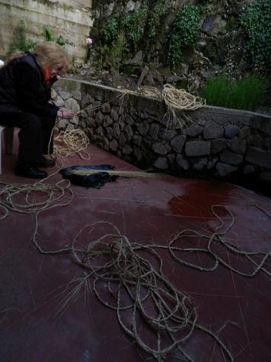
The traditional practice of braiding chilliqua to make rope

Slide 19
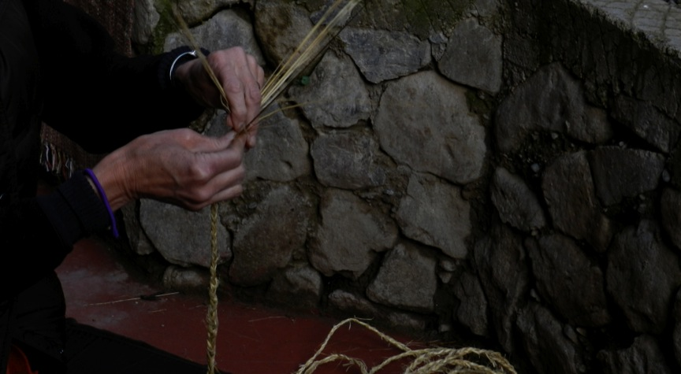
The Braiding process

Slide 20
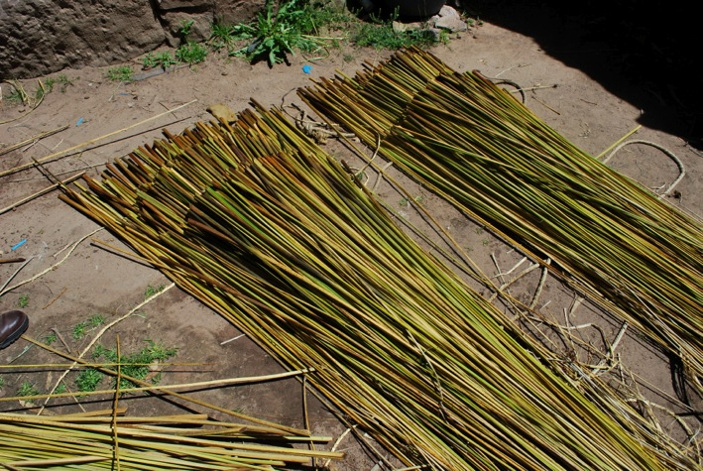
The reeds

Slide 21
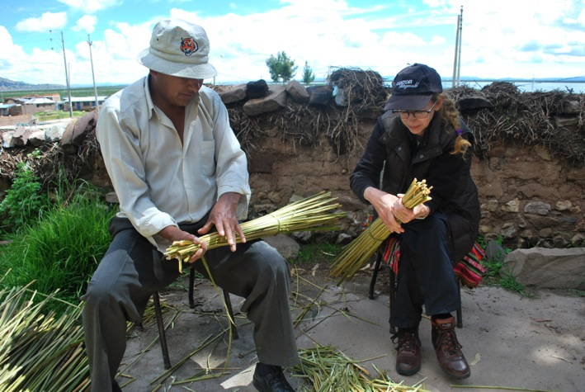
First step: building a balsa model to understand the process

Slide 22
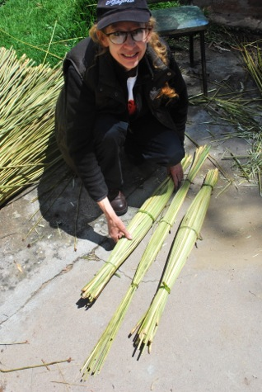
Basic structure: 3 tubes of bound reeds

Slide 23
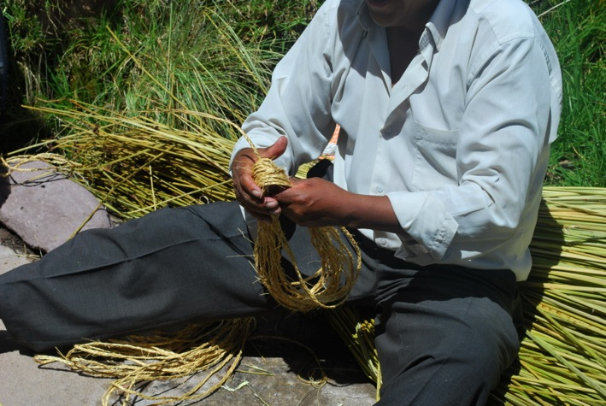
The rope for lashing the tubes together

Slide 24
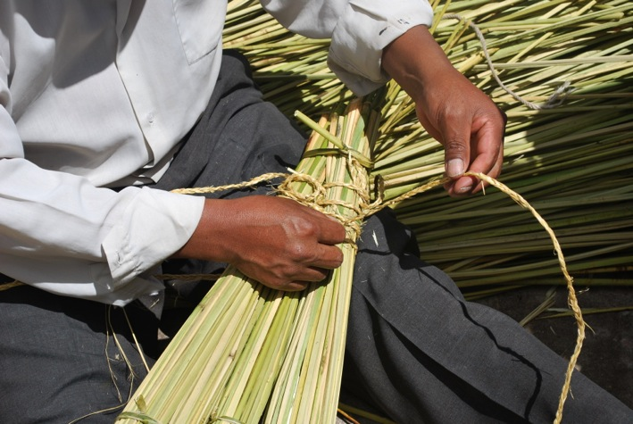
Weaving the tubes together

Slide 25
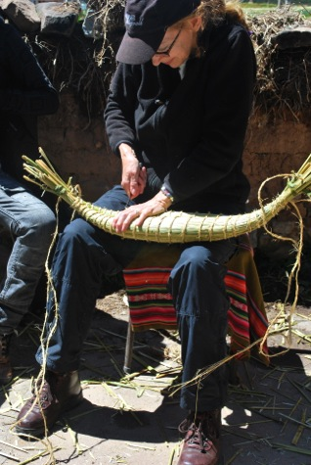
Pulling the rope taught to compress the reeds

Slide 26
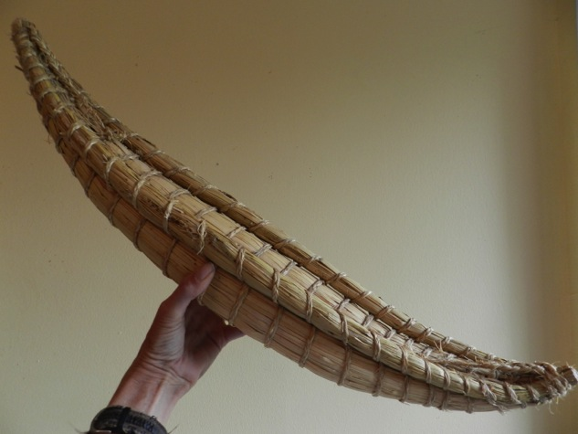
Balsa model completed

Slide 27
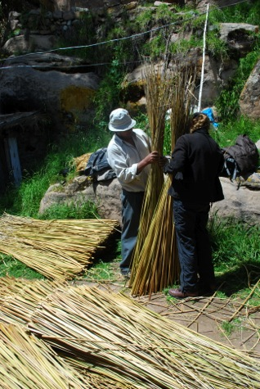
Next Step: Building the full size balsa

Slide 28
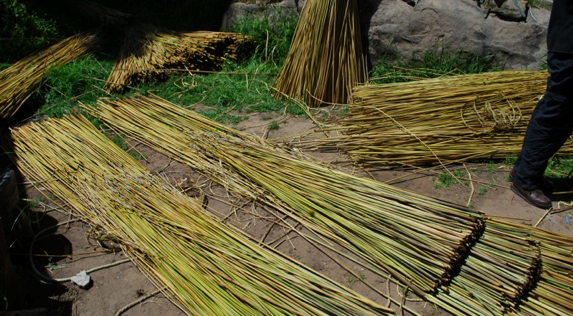
Arranging the reeds into 3 bundles

Slide 29
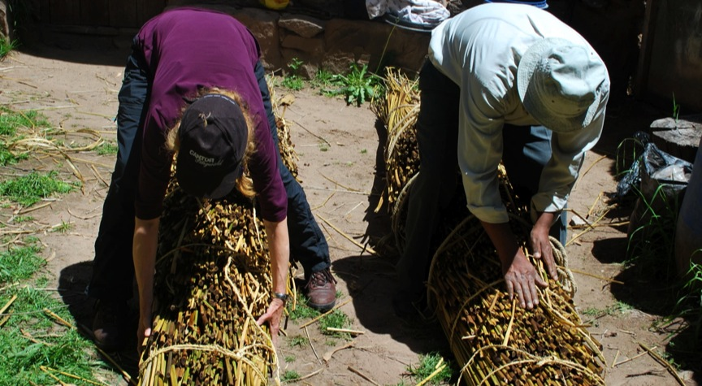
Tying the bundles at successively diminishing lengths

Slide 30
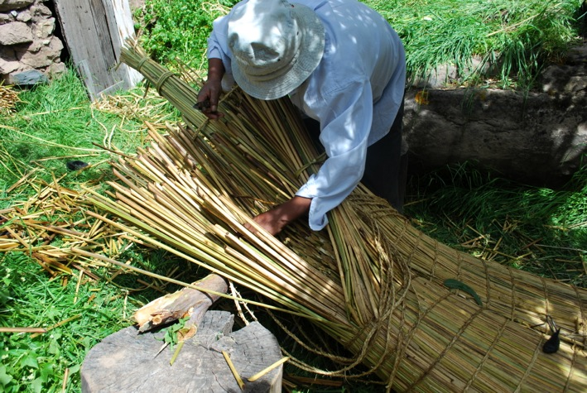
Adding reeds to build-up the circular bow form

Slide 31
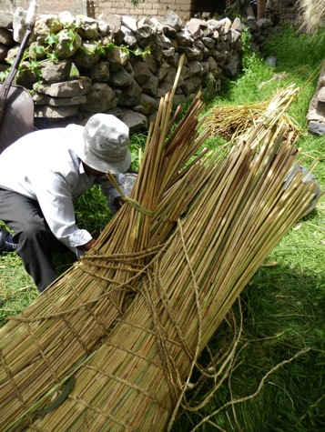
Lashing the 3 bundles together with chilliqua rope

Slide 32
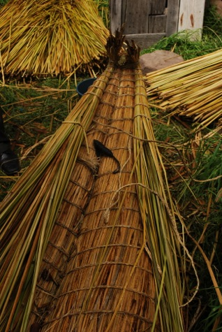
Balsa in progress

Slide 33
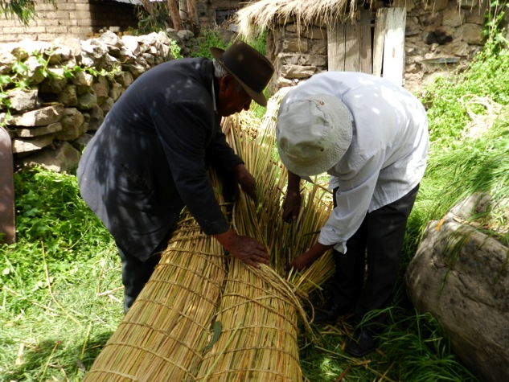
Juans’ 92 year old father offers advice on the project

Slide 34
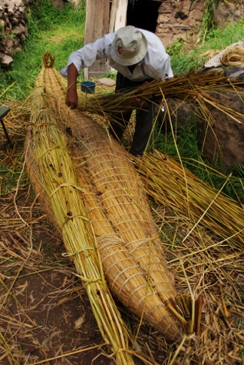
The boat In progress

Slide 35
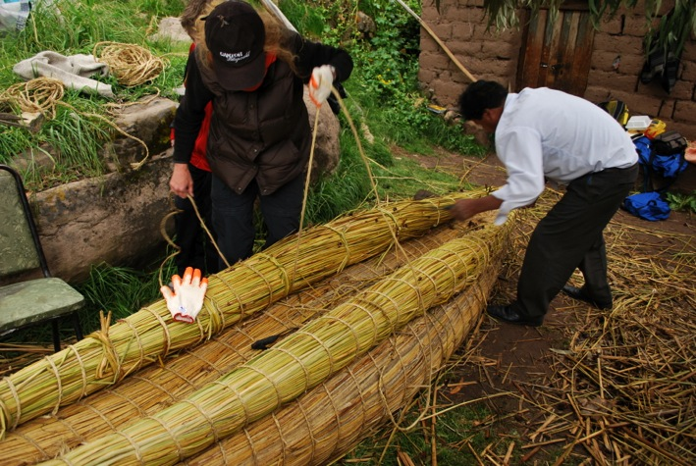
Tightening the ropes to compress the reeds

Slide 36
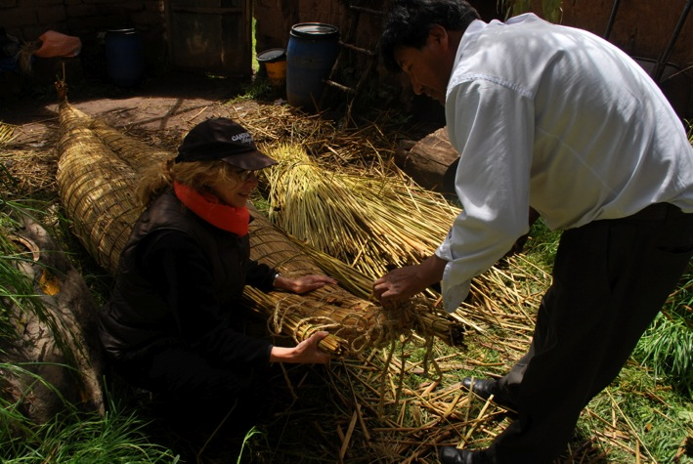
Tying the points at each end

Slide 37
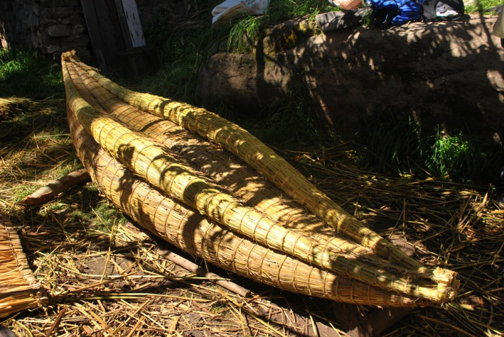
Our completed balsa named “Ispi” or “Little fish” in Aymara

Slide 38
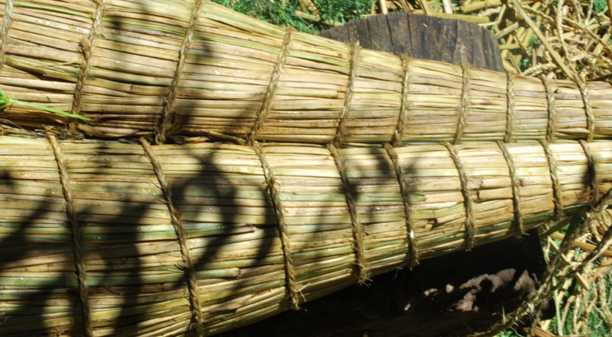
Geometric Detail

Slide 39
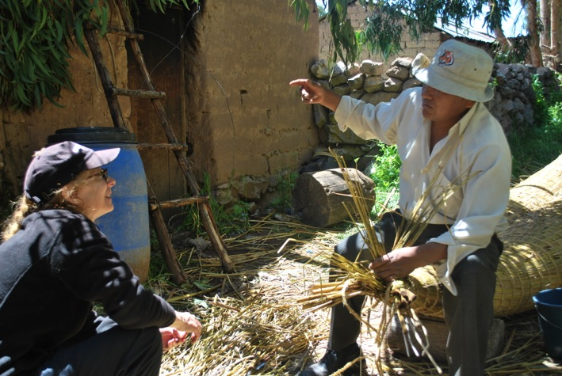
Stories of Lake Titicaca

Slide 40
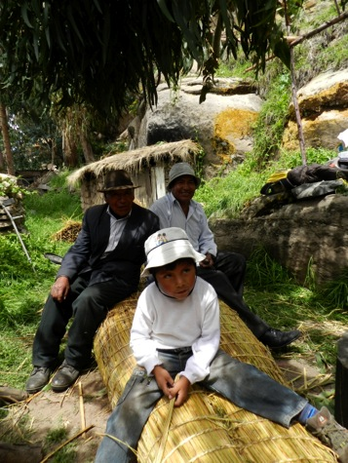
Three generations from Chimu

Slide 41
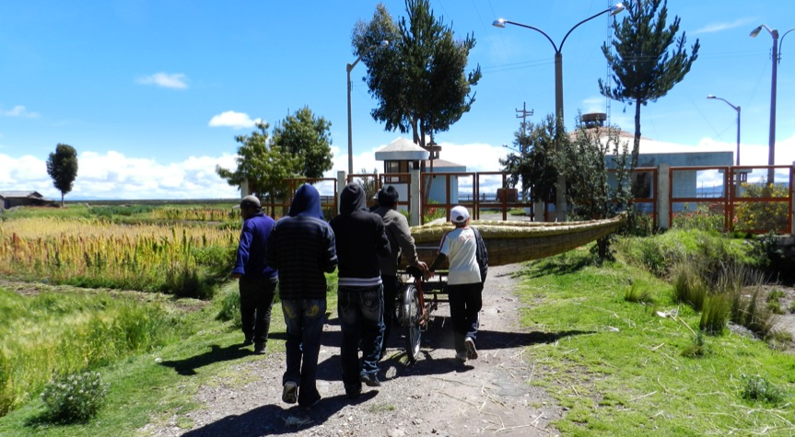
Launch Day: Wheeling Ispi to Lake Titicaca

Slide 42
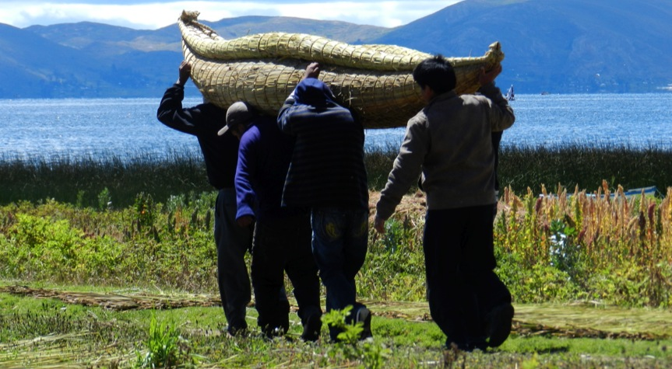
Local men transporting Ispi to the shore

Slide 43
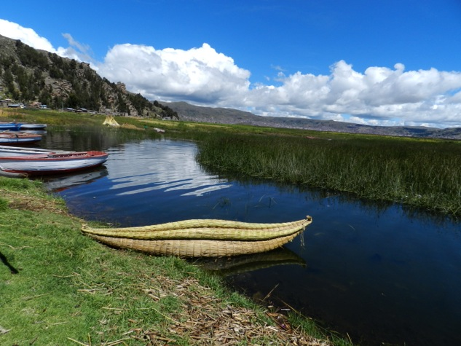
Ispi water bound

Slide 44
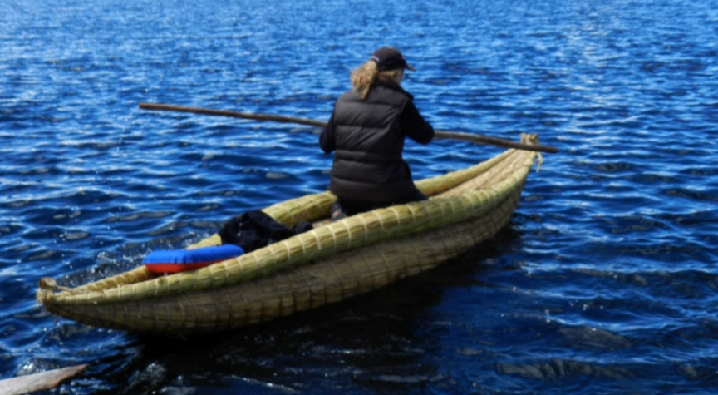
Trial run!

Slide 45
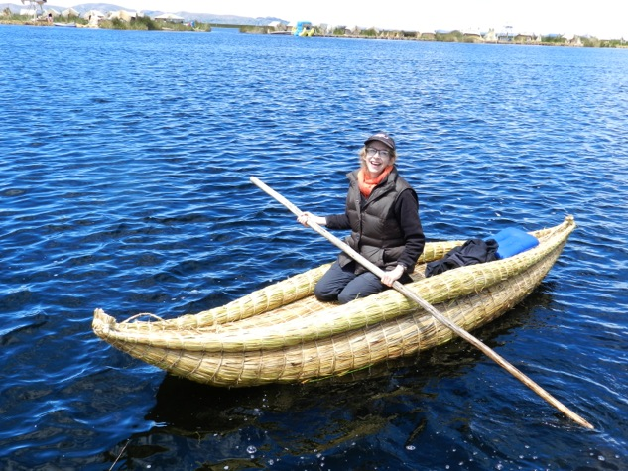
Success!

Slide 46
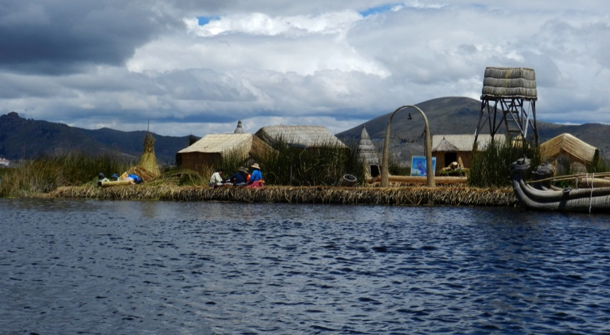
Kayaking on Ispi to the floating Uros islands off the Puno coast

Slide 47
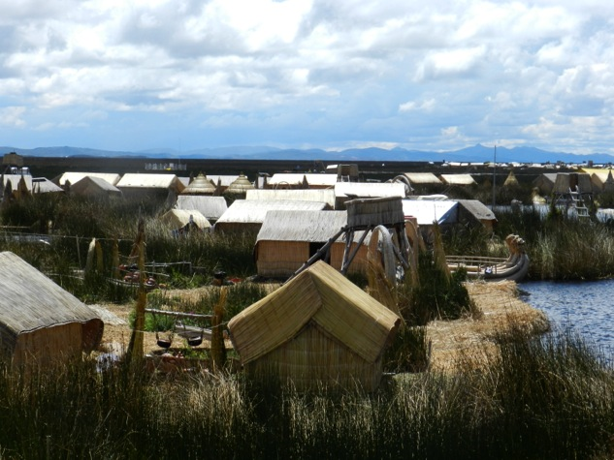
The Uros Community:Floating islands fabricated with totora reeds

Slide 48
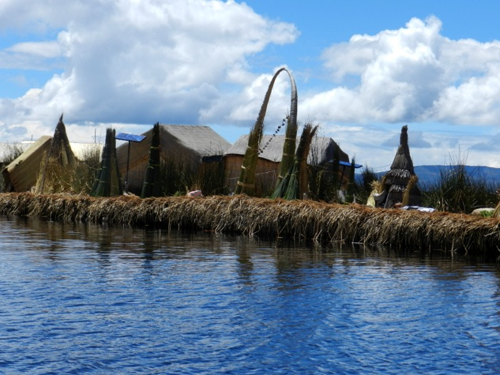
Layers of built-up totora reeds create the floating island structures

Slide 49
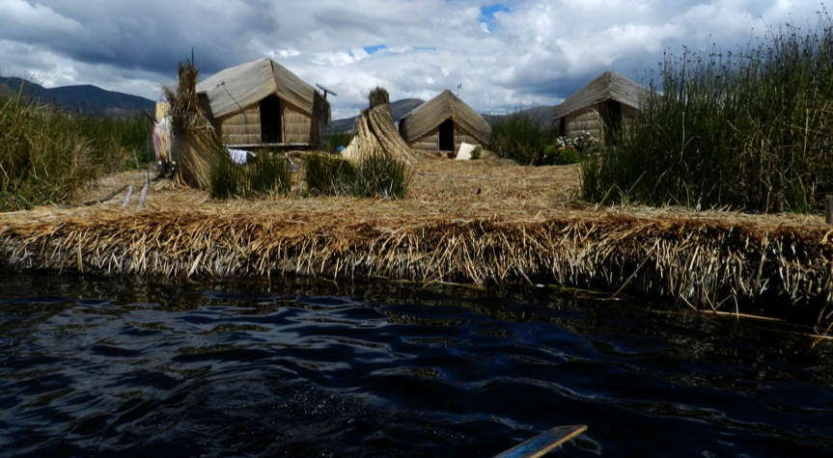
Water’s edge view of compacted totora reeds, Uros Islands, Puno

Slide 50
From Balsa to Sculpture
Consequently, I wanted to apply the knowledge of working with totora reeds to my own sustainable sculpture process….
I proposed to build a sculpture for the atrium of the Peruvian North American Cultural Institution in Puno

Slide 51
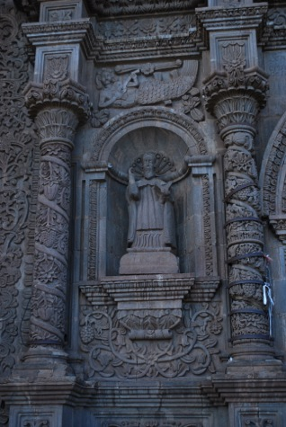
…inspired by the mermaids on the Puno Cathedral facade

Slide 52
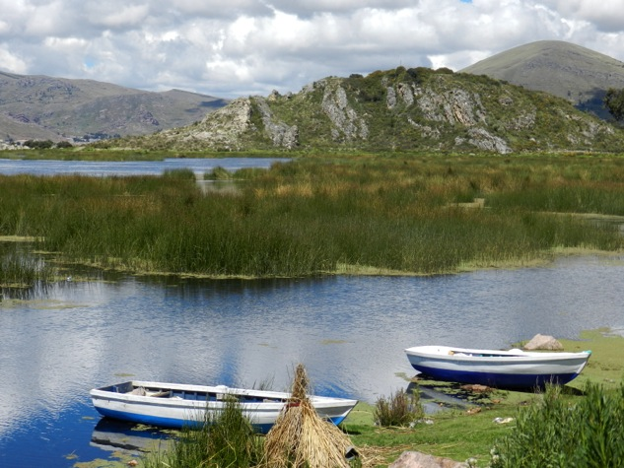
We picked-up the totora in a taxi

Slide 53

..for transport from the lake to ICPNA

Slide 54

Dried totora

Slide 55

Ready to begin the project

Slide 56

Drying reeds on the patio for the sculpture

Slide 57

Building the Mermaid structure with bamboo

Slide 58

….and totora reeds

Slide 59

Installation Day

Slide 60

Installation team

Slide 61

The Mermaid (La Sirena)

Slide 62

“La Sirena” rear view seen from above

Slide 63

Opening night with the Mayor of Uros and Uros community members

Slide 64

Transporting the mermaid from ICPNA to the Cathedral

Slide 65

with permission from the Bishop of Puno

Slide 66

to exhibit the mermaid on the Cathedral façade, Puno

Slide 67
My Project continues….
My goal now is find support that will allow me to expand upon my research by building a floating sculpture island made of totora reeds and bamboo. The island structure will be built on Lake Titicaca shoreline of Chimu on the property of Juan Cuno’s family for the benefit of the community of Ichu and the public.

